Slide 1


Assignment 3 – Virtual Presentation and Interview
Practical Data Science With Python

Slide 2
I certify that this is all my own original work. If I took any parts from elsewhere, then they were non-essential parts of the assignment, and they are clearly attributed in our submission. I will show I agree to this honor code by typing “Yes”:
Pranav Karnth Mannur
s3828461

Slide 3
ABSTRACT:
Collaborative filtering (CF) is one of the most successful technologies in recommender systems, and widely used in many personalized recommender areas, such as ecommerce, digital library and so on. However, most collaborative filtering algorithms suffer from data sparsity which leads to inaccuracy of recommendation. In this paper, we focus on nearest-neighbor CF algorithms and propose a new collaborative filtering approach. First, we suggest a new missing data making up strategy before user’s similarity computation, which smoothes the sparsity problem. Meanwhile, the notion of item’s popularity weight is defined and introduced into the computation. After then, when facing with new users, we also find a kind way to alleviate the difficulty in recommendation. The experimental results show our proposed approach outperforms the other existing collaborative filtering algorithms. It can efficiently smooth the inaccuracy caused by ratings sparsity, and can work well in generating recommendation for new users.

Slide 4
How the solution in the provided report can improve the performance of the user KNN-based Collaborative Filtering method?
Weaknesses in the current CF process:
Existing methods seldom think about the items with different popularity may reflect different importance in computation
Sparsity Problem – missing data
New User problem – new user in the system
For example, in an e-commerce website, a popular item “Laptop” and an unpopular item “Mouse” indicate different weight in evaluating user’s similarity.

Slide 5
How the solution in the provided report can improve the performance of the user KNN-based Collaborative Filtering method?
new missing data making up strategy before computing user’s similarity. This method can smooth the sparsity problem to a certain extent.
define item’s popularity weight and introduce it into the computation of similarity. The result will be accurate to generate user’s true neighbors.
prediction and recommendation step, we try a new method for new users by defining item’s composite recommendation value (ComRV), by which whether an item is recommended or not is decided.

Slide 6
How the solution in the provided report can improve the performance of the user KNN-based Collaborative Filtering method?
User’s Similarity Computation and KNN Selection: Steps:
A: Calculate the union set T(a,u) of the items voted by user a or user u , that isT(a,u) = T(a) U T(u).
B: For user a , find the item set he hasn’t rated in T(a,u) , we denote it as N(a ), N(a) = T(a,u) T(a), then make up the missing data on every item j in N(a). Finally, use the result as the making up data. Likewise, for user u, we make up the missing data on every item in N(u) . After this done, the number of common rated items by a and u becomes more.

Slide 7
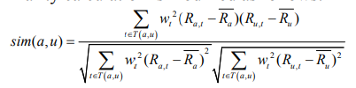
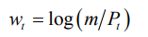
How the solution in the provided report can improve the performance of the user KNN-based Collaborative Filtering method?
User’s Similarity Computation and KNN Selection: Steps:
C: Similarity computation utilizing item’s popularity:
we define the popularity significance weight of item t as follows: log (m/Pt) = Wt
After then, we introduce this weight in PCC measure. The similarity calculation is modified as follows:
D: K-nearest neighbors’ selection:
After computing all similarity values between the active user a and every other user in the database, we sort the results in descending order, and form a neighbor set KNN(a) = {knn1, knn2,…, knnk }, here sim(a,knn) >= sim(a,knn) >=……>= sim(a, knnk).

Slide 8
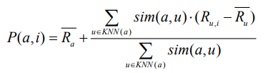
How the solution in the provided report can improve the performance of the user KNN-based Collaborative Filtering method?
Prediction and Recommendation : Steps:
Prediction and Recommendation for Active Users:
The active user's predictions on non-rated goods are based on their neighbours' ratings data on those products. Then, based on the Top-N highest prediction value, construct a list of recommended items for user a.
Prediction and Recommendation for New Users:
In this stage, we discover that if a new user is using the system for the first time, it can be difficult to offer the appropriate things for him due to the lack of rating data from him. We compile statistics to determine the Top-N most popular things that are also highly rated. Pt is the popularity, and Rt is the mean rating value of item t.
ComRV(t) = Pt. Rt^

Slide 9
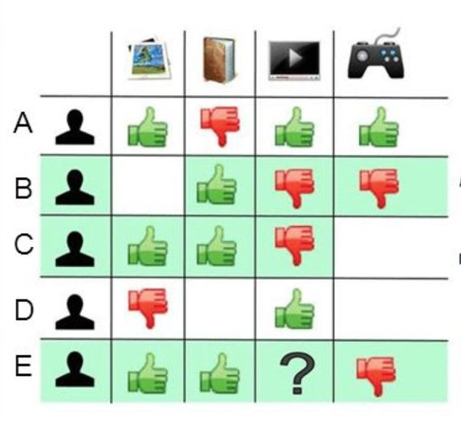
Why the solution in the provided report can improve the performance of the user KNN-based Collaborative Filtering method?
The sparsity problem is alleviated by making every two users have more common rated goods, according to an innovative technique for filling in missing data.

Slide 10
Why the solution in the provided report can improve the performance of the user KNN-based Collaborative Filtering method?
In order to compute similarity, we propose using an item's popularity weight.

Slide 11
Why the solution in the provided report can improve the performance of the user KNN-based Collaborative Filtering method?
New User problem: When a new user is in the system.
ComRV(t) = Pt. Rt^
When dealing with new users in the recommendation step, we assign a composite recommendation value that includes the item's popularity and mean rating value. New users will be suggested and satisfied with things that have the greatest Top-N ComRV.

Slide 12
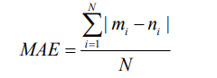
Why the solution in the provided report can improve the performance of the user KNN-based Collaborative Filtering method?
Evaluation Metrics:
We compare the prediction quality of our proposed methodology with various collaborative filtering approaches using the Mean Absolute Error (MAE) metrics.
If the prediction ratings set of N users is {m1, m2, m3…mN} , and corresponding true ratings set is {n1, n2, n3…nN}, MAE is defined by the above equation.

Slide 13
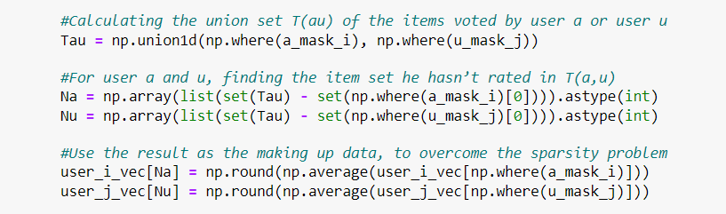
Implementation of the solution:
New missing data making up strategy before computing user’s similarity. This method can smooth the sparsity problem to a certain extent.

Slide 14
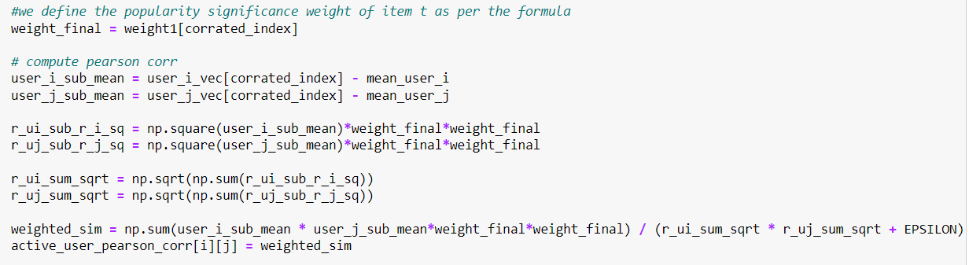
Implementation of the solution:
define item’s popularity weight and introduce it into the computation of similarity. The result will be accurate to generate user’s true neighbors.

Slide 15
Implementation of the solution:
define item’s popularity weight and introduce it into the computation of similarity. The result will be accurate to generate user’s true neighbors.

Slide 16
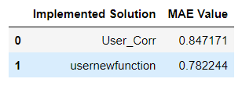
Implementation of the solution:
Computing the metrics:
Before: MAE: 0.8471711011333851, RMSE: 1.092846045041526
After: MAE: 0.7822435788080622, RMSE: 1.002498090002132

Slide 17
Thank you!

